Slide 1

Metro Station with Dijkistra
- Metro mapper

Slide 2
Team members
Vyshnavi P
Harine V
P Sree Neha
CH.EN.U4CSE21180
CH.EN.U4CSE21121
CH.EN.U4CSE21147

Slide 3

Table of contents
01
02
03
04
Problem statement
Abstract
Who are we solving the problem for?
Overall description of our project
Data structure used
Code implementation
Curious on what data structure we used to solve our problem?
Code running and output

Slide 4
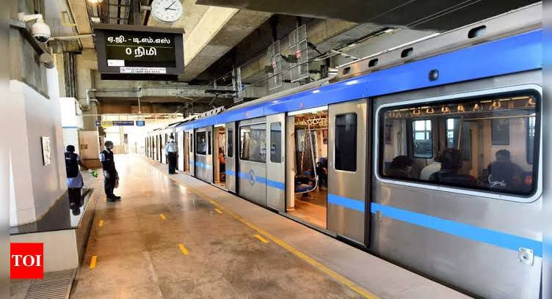
01
Problem statement
The problem statement is the difficulty faced by commuters and tourists in finding stations and the most efficient route between two metro stations. This can be challenging, especially in large and complex metro networks, and can result in wasted time, missed appointments, and unnecessary stress.

Slide 5
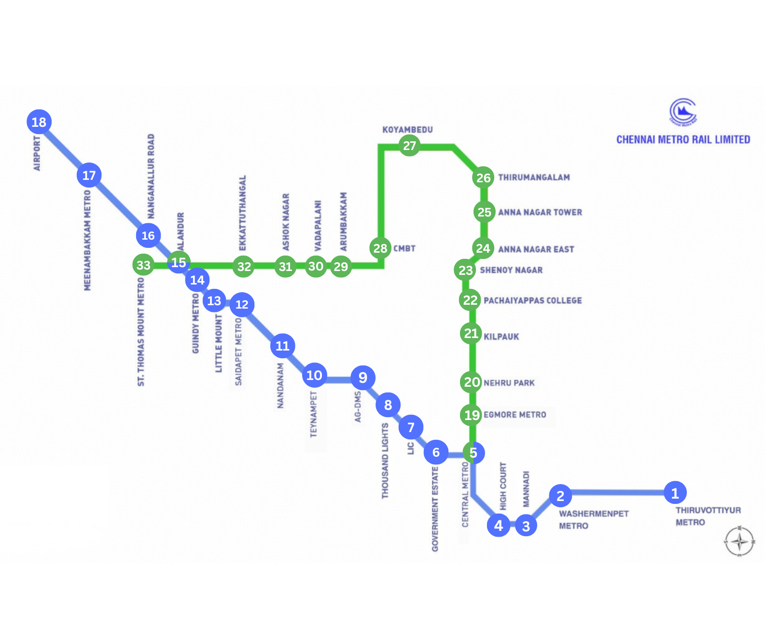

Abstract
02
This is a project that utilizes the Dijkstra algorithm and graph theory to predict the number of stations between a source and destination on a metro network. The program provides an accurate prediction of the best route to take

Slide 6
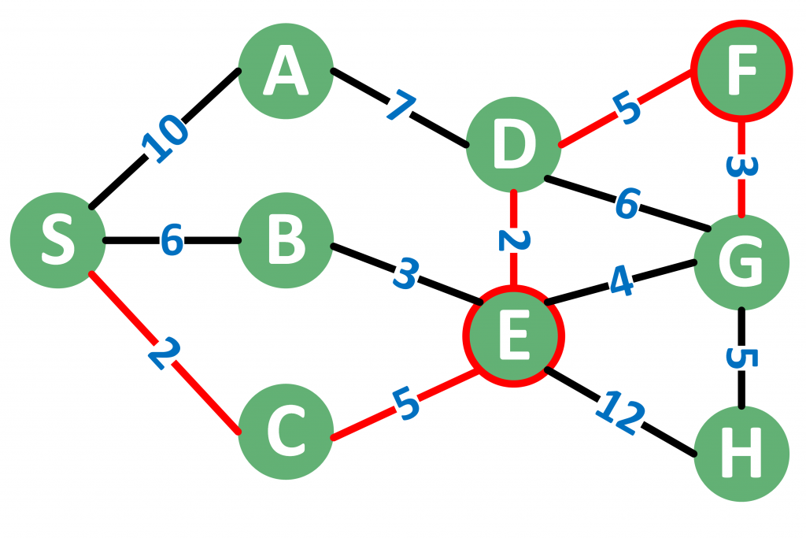
Data structure used
Graph
Dijkistra algorithm

